Slide 1
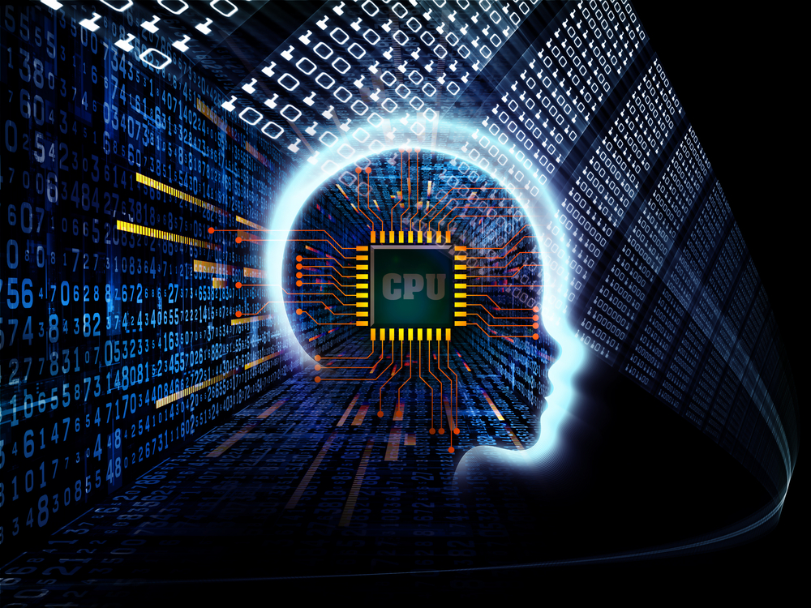
Can AI and Classical Programming Redeem Each Other?
Mayur Naik
Associate Professor Computer & Information Science

Slide 2

Acknowledgments
Halley Young
Xujie Si
Sulekha Kulkarni
Mukund Raghothaman
Yuan Yang (PhD Student)
Hanjun Dai (PhD Student)
PhD Students
Postdocs
Collaborators
Pardis Pashakhanloo
Jiani Huang
Elizabeth Dinella
Kihong Heo
Osbert Bastani (Faculty)
Le Song (Faculty)
Undergraduate Students: Gianluca Gross, Trevor Huang, Bradley Jackson, Jessica Landon, Will Lowe, Tessa Bloomer, Jina Lo, Tiffany Tsang, Yuewei Yuan, Saron Mosazghi, Ana Machaidze. High-School Student: Neelay Velingker

Slide 3
Classical Programming vs. AI A Tale of Two Software Approaches
Output layer
Input layer
Hidden layer
Written in code (Python, C++, …)
Explicit instructions to the computer written by a programmer
Requires domain expertise
Written in neural networks
Weights learnt by optimization (no human involved)
Requires (lots of) data

Slide 4
Classical Programming vs. AI Success Stories
1990’s: Enterprise software
2008: Github.com 57M source code repositories
2008: App marketplaces 6M apps (Android and iOS)
2012: Visual Recognition
2014: Machine Translation
2016: Strategy Games (Chess, Go, …)

Slide 5

Classical Programming vs. AI Grand Challenges
Security vulnerabilities
Software performance
Adversarial attacks
Labeling problems
40 vulnerabilities / day in 2017 120% increase over 2016
Size of Linux kernel ver. 4.19: > 25 million LOC

Slide 6
Talk Outline
Leveraging PL techniques to solve AI challenges
Applications: computer vision, natural language processing, robotics, …
Techniques: program synthesis, symbolic reasoning
Leveraging AI techniques to solve PL challenges
Applications: software verification, refactoring, defect prediction, …
Techniques: Neural nets, probabilistic graphical models

Slide 7
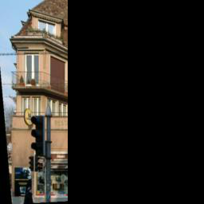
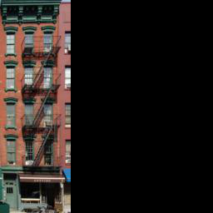

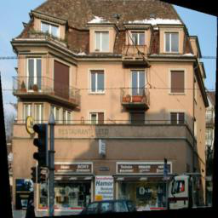
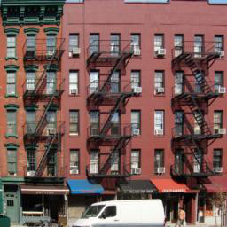

An Example Problem: Image Completion
INPUT 1/3rd of image
REFERENCE
OUTPUT

Slide 8
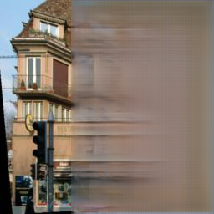
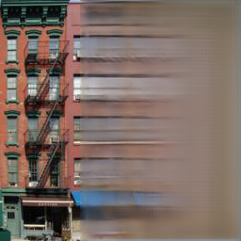
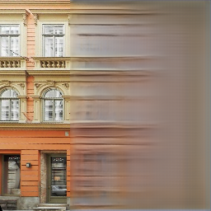
Contemporary Approach: GLCIC*
GENERATED
OUTPUT
REFERENCE
OUTPUT
Globally and Locally Consistent Image Completion, SIGGRAPH 2017

Slide 9
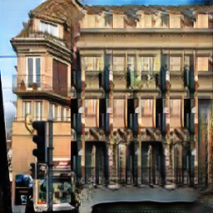
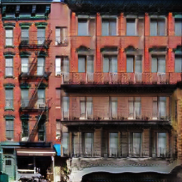

Our Approach
GENERATED
OUTPUT
REFERENCE
OUTPUT

Slide 10
Contemporary Approach
Step 1 [Offline]: Train generative neural net to complete images

Slide 11
Contemporary Approach
Step 2 [Online]: Apply learnt model to complete unseen images

Slide 12
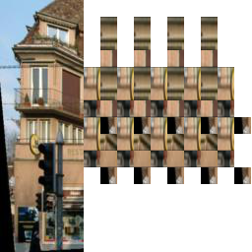
Our Approach: Neuro-Symbolic Models
Step 1 [Offline]: Discover structure by synthesizing classical program
for i = 1..2
for j = 1..8
draw( , i*3 + 2, j*2 + 0)
...

Slide 13
Our Approach: Neuro-Symbolic Models
Step 2 [Offline]: Train neural net to complete synthesized image

Slide 14
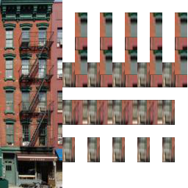
Our Approach: Neuro-Symbolic Models
Step 3 [Online]: Discover structure in input partial image
for i = 1..3
for j = 1..7
draw( , i*3 + 5, j*2 + 1)
...

Slide 15
Our Approach: Neuro-Symbolic Models
Step 4 [Online]: Apply learnt model to complete synthesized image

Slide 16
An Example Problem: Program Verification
assume (x >= 0)
y = 0;
while (x != y) { y = y + 1; }
assert (x == y)
assume (n >= 0)
i = 0; a = 0; b = 0;
while (i < n) { if (*) { a += 1; b += 2; } else { b += 1; a += 2; } }
assert (a + b == 3 * n)
assume (true)
x = 0; m = 0; while (x < n) { if (*) m = x; x = x + 1; } if (n > 0) assert (m <= n)
INPUT
>=
&&
&&
<=
==
||
||
x
y
OUTPUT (Loop Invariant)
i
n
+
*
>=
>
<=
>
a
b
3
i
m
0
x
0
m
0
n
m

Slide 17
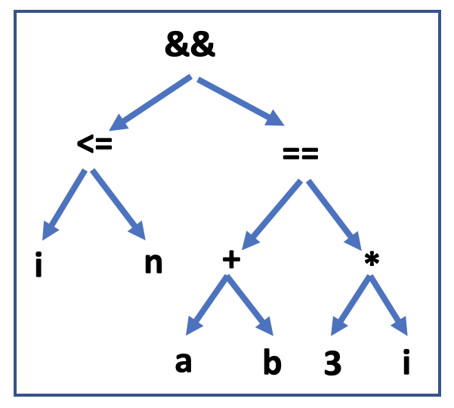
Our Approach
Learning Loop Invariants for Program Verification. Neural Information Processing Systems, Dec 2018.
assume (x == 1 /\ y == 1)
while (y < 1000) {
x = x + y;
y = y + 1; } assert (x >= 1600)
Counter-
Examples

Slide 18
Our Approach: Deep Reinforcement Learning
Step 1: Encode program as a graph that captures its rich structure
while (y < 1000) { x = x + y; y = y + 1; }

Slide 19
Our Approach: Deep Reinforcement Learning
Step 2: Convert the graph to a vector representation using a graph neural network

Slide 20
Our Approach: Deep Reinforcement Learning
Step 3: Model loop invariant generation as multi-step decision making

Slide 21
Comparison to State-of-the-Art Approaches
Verification Cost
Sample Complexity

Slide 22
Programmer-Assisted AI: Program Refactoring

Slide 23
Programmer-Assisted AI: Program Refactoring
Effective Program Debloating via Reinforcement Learning. ACM Conference on Computer and Communications Security (CCS), Oct 2018.

Slide 24


Programmer-Assisted AI: Defect Prediction
Confidence | Alarms
0.81 | R2: Race on field org.apache.ftpserver.RequestHandler.request
 | org.apache.ftpserver.RequestHandler:17 | org.apache.ftpserver.RequestHandler:18
0.53 | R3: Race on field org.apache.ftpserver.RequestHandler.writer
 | org.apache.ftpserver.RequestHandler:19 | org.apache.ftpserver.RequestHandler:20
0.35 | R4: Race on field org.apache.ftpserver.RequestHandler.reader
 | org.apache.ftpserver.RequestHandler:21 | org.apache.ftpserver.RequestHandler:22
0.30 | R1: Race on field org.apache.ftpserver.RequestHandler.request
 | org.apache.ftpserver.RequestHandler:9 | org.apache.ftpserver.RequestHandler:18
0.23 | R5: Race on field org.apache.ftpserver.RequestHandler.controlSocket
 | org.apache.ftpserver.RequestHandler:23 | org.apache.ftpserver.RequestHandler:24

Slide 25
Programmer-Assisted AI: Defect Prediction
Confidence | Alarms
0 | R2: Race on field org.apache.ftpserver.RequestHandler.request
 | org.apache.ftpserver.RequestHandler:17 | org.apache.ftpserver.RequestHandler:18
0.81
0.28 | R3: Race on field org.apache.ftpserver.RequestHandler.writer
 | org.apache.ftpserver.RequestHandler:19 | org.apache.ftpserver.RequestHandler:20
0.53
0.18 | R4: Race on field org.apache.ftpserver.RequestHandler.reader
 | org.apache.ftpserver.RequestHandler:21 | org.apache.ftpserver.RequestHandler:22
0.35
0.30 | R1: Race on field org.apache.ftpserver.RequestHandler.request
 | org.apache.ftpserver.RequestHandler:9 | org.apache.ftpserver.RequestHandler:18
0.30
0.12 | R5: Race on field org.apache.ftpserver.RequestHandler.controlSocket
 | org.apache.ftpserver.RequestHandler:23 | org.apache.ftpserver.RequestHandler:24
0.23

Slide 26
Programmer-Assisted AI: Defect Prediction
Confidence | Alarms
0 | R2: Race on field org.apache.ftpserver.RequestHandler.request
 | org.apache.ftpserver.RequestHandler:17 | org.apache.ftpserver.RequestHandler:18
0.28 | R3: Race on field org.apache.ftpserver.RequestHandler.writer
 | org.apache.ftpserver.RequestHandler:19 | org.apache.ftpserver.RequestHandler:20
0.18 | R4: Race on field org.apache.ftpserver.RequestHandler.reader
 | org.apache.ftpserver.RequestHandler:21 | org.apache.ftpserver.RequestHandler:22
0.30 | R1: Race on field org.apache.ftpserver.RequestHandler.request
 | org.apache.ftpserver.RequestHandler:9 | org.apache.ftpserver.RequestHandler:18
0.12 | R5: Race on field org.apache.ftpserver.RequestHandler.controlSocket
 | org.apache.ftpserver.RequestHandler:23 | org.apache.ftpserver.RequestHandler:24

Slide 27
Programmer-Assisted AI: Defect Prediction
User-Guided Program Reasoning Using Bayesian Inference. ACM Conference on Programming Language Design and Implementation, June 2018.

Slide 28
Conclusions
PL 4 AI: Combining machine learning / deep learning with logic / prior knowledge will bring next wave of improvements for AI
In computer vision, natural language processing, robotics, …
AI 4 PL: Automated reasoning for classical programs is grand AI challenge
Improve programmer productivity and software quality for the masses
Many exciting challenges lie at the intersection of PL and AI
Transfer learning / meta learning / lifelong learning
Human-assisted AI

